Slide 1

Growing social entrepreneurs as leaders Debbie Forster, MBE @debbieforster

Slide 2
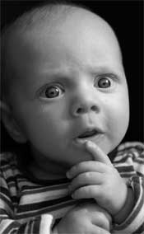
How did I get here… & what is that accent?

Slide 3
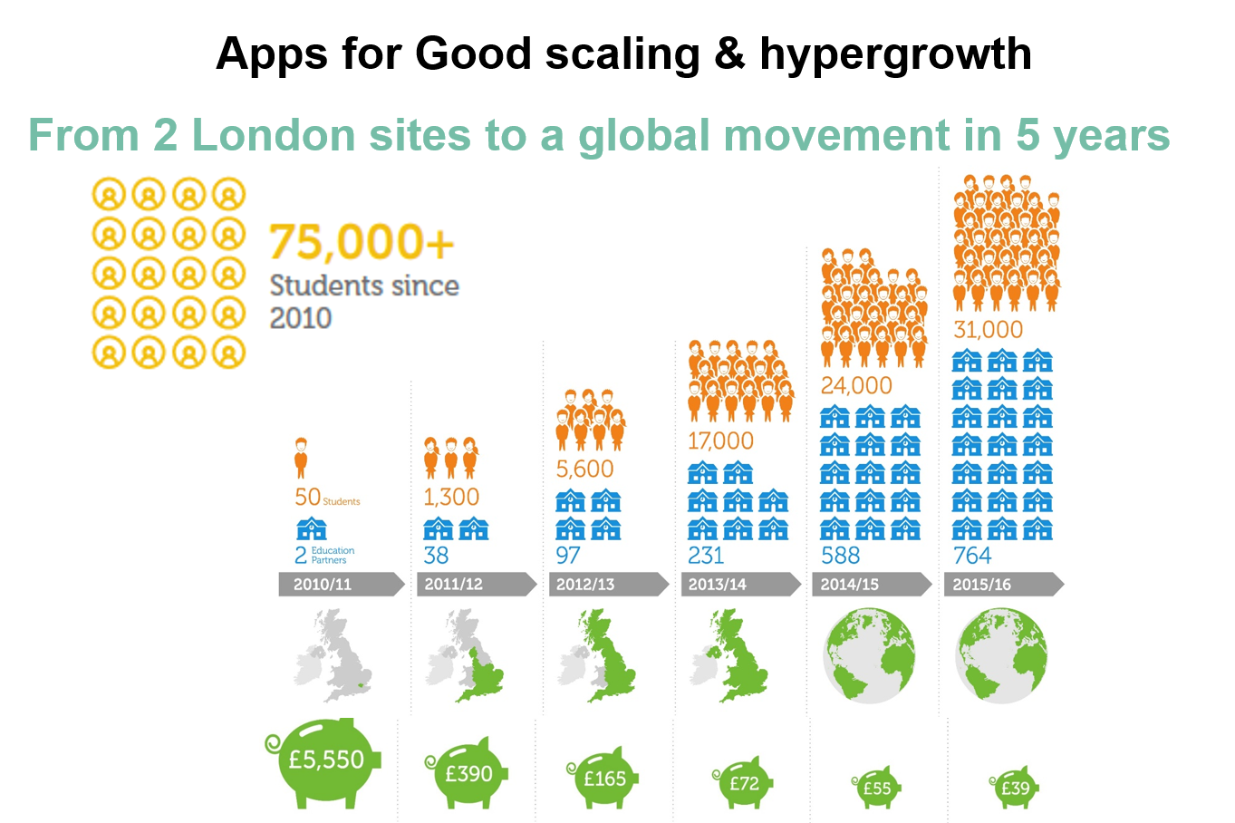
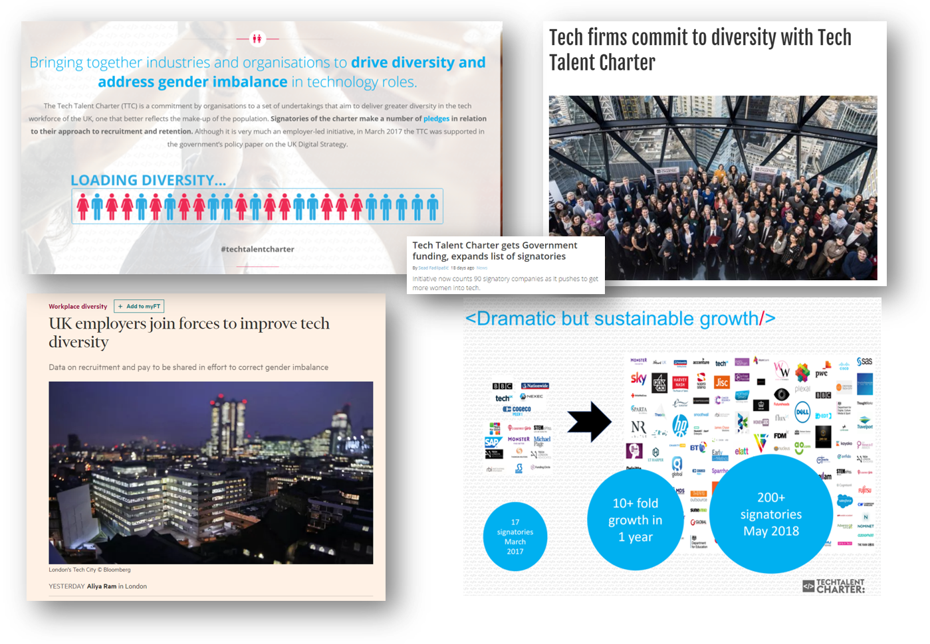
My background- Both “doing” and helping others “do it”

Slide 4

Workshop Goals
To develop your team’s knowledge & confidence in development of leadership/management skills
To map out areas of expertise/existing practice within Unltd in each of the core areas
To develop/refine shared resources/ways of working/tools to use in future
To not need me for this again!

Slide 5
Workshop approach Theory + Shared Experience -> Shared definitions + approaches
Day 1 – Leadership-internal capacity & skills
Day 2 – Find a great team
Day 3 – Retain & grow a great team

Slide 6

Taking stock— What is your goal in terms of leadership development at Unltd?
Small group discussion

Slide 7
Taking stock— What do we have in place already?
What do we know?
What systems/materials do we have in place?
How do we use it?
Small group discussion
We will start with this at the start of each session.

Slide 8

Taking stock— Where do we want to be?
What do we need to know?
What materials support do we want to have in place?
How will we use it, track it and improve it?
Small group discussion
We will check in with this at the end of each session

Slide 9
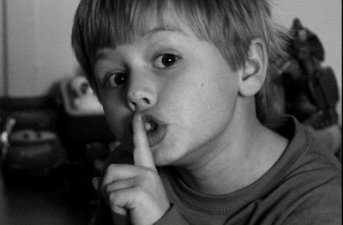
One of the great secrets of leading a scale-up? There aren’t any. Myth-busting

Slide 10


It’s easy for social entrepreneurs to get lost in all the advice on “How to be a Great Leader” and “5 Habits of Great Entrepreneurs” And to feel overwhelmed & like failures.

Slide 11
But most articles & courses ignore the realities of the scaling social enterprise
The only thing They have less than money is time
Often they have to lead and manage and do
the cost of mistakes is people not profits
It’s rarely why they got into this in the first place!

Slide 12
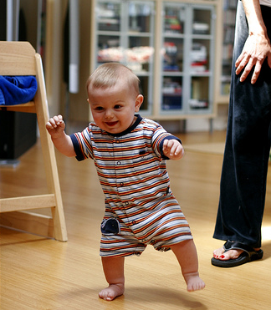
And never really understand this is“their baby”.

Slide 13
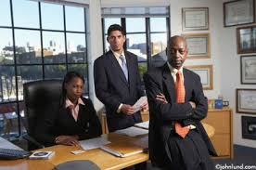
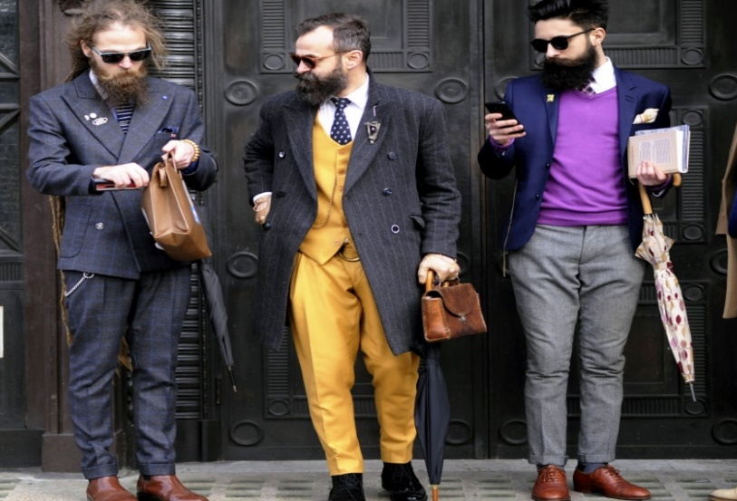

What is the difference between Founders, Entrepreneurs & CEO’s? What is our “typical” definition for each of these roles?
Small group discussion

Slide 14

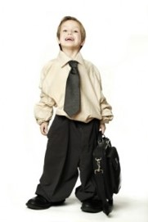
Do any of these fit our social entrepreneur? What parts of the definitions might we hold on to?
Small group discussion

Slide 15
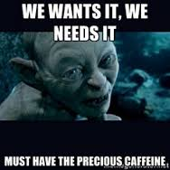
Break time 10 minutes

Slide 16
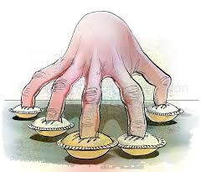

What does it really mean to lead a social enterprise?

Slide 17
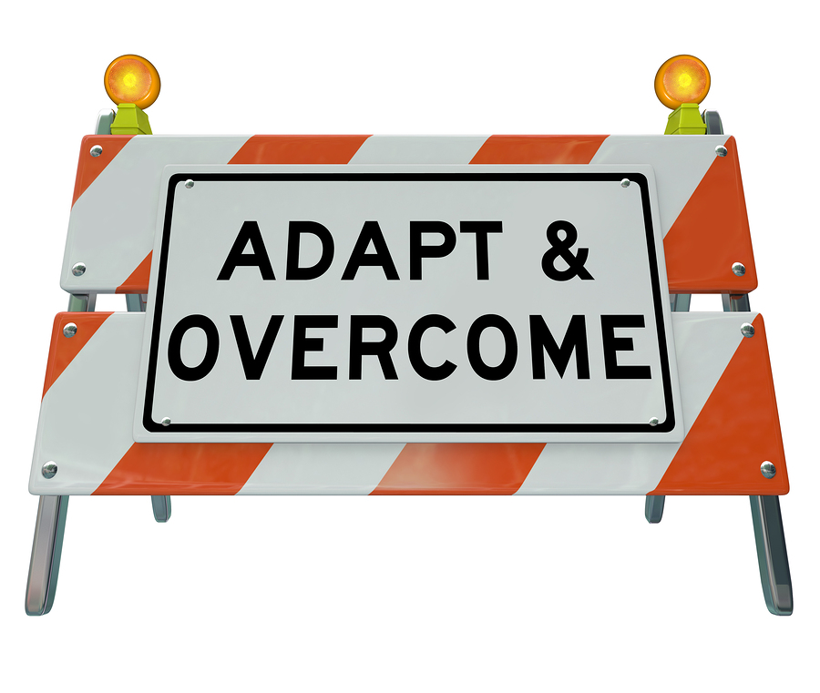
Challenges we need to help them with
Leadership vs management
Balancing roles
Understanding leadership style
Delegation & moving from “I” to we
Understanding core leadership priorities
Often this is not new learning,
but a need to reflect, remember and action.
We don’t need to “fix” them but to equip them for the journey.

Slide 18


To help social entrepreneurs, we need to change the rules, give them time to reflect and help them find their own definitions but to keep it grounded in the practical.

Slide 19
What does leading a social enterprise involve?
What kinds of activities make up a typical day/week/month?
Can they be grouped together into some broad categories?
Small group discussion

Slide 20
Types of activities which take their time: Core Leadership Priorities
Strategy
People
Story
Structure

Slide 21
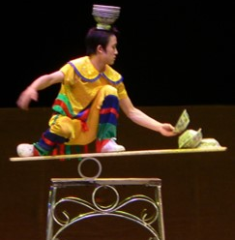
Balancing strategy & operations

Slide 22
As they scale, the balance shifts. They need more helicopter & less ground command. The key is to understand when and how to shift.

Slide 23
Helping them let “their baby” grow up.
Delegation & succession planning—moving from “I” to “we”

Slide 24
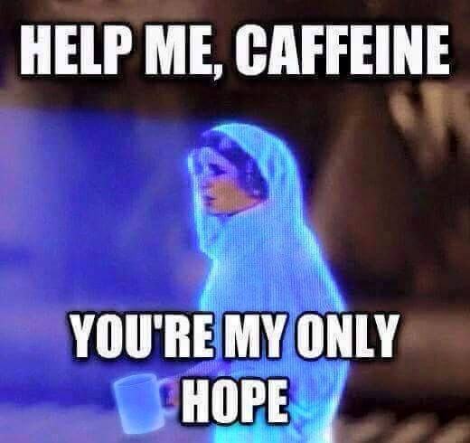
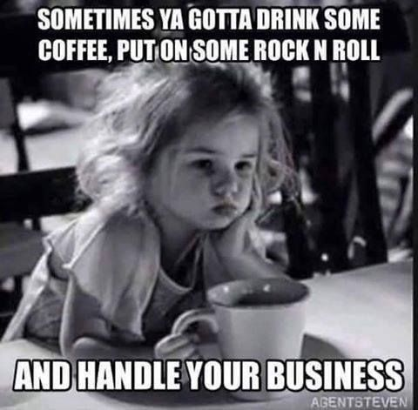
And the biggest problem?
Social entrepreneurs rarely make time for themselves to learn, reflect, plan… or to recharge.

Slide 25
They know this, so why aren’t they balancing things?
What is keeping them from balancing strategic & operational?
Internal factors
External factors
Small group discussion

Slide 26
How do we help them with this?
How do we help them overcome this?
How to understand causes?
How to help them overcome them?
Small group discussion

Slide 27

Leadership Style—It’s not a single outfit.

Slide 28
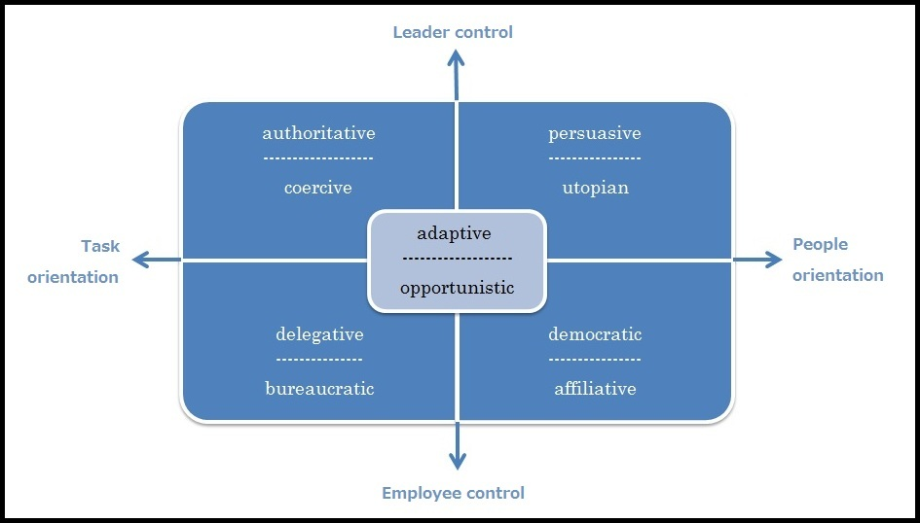
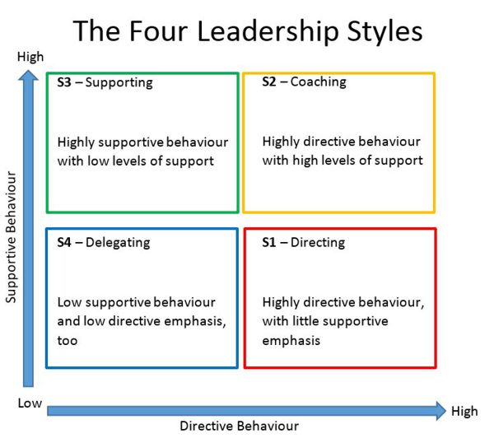
Some great theory out there on leadership styles, but it’s not enough

Slide 29

The key is to help them see it as a toolkit or repertoire. Help them learn their “core” & how or when to vary it.

Slide 30
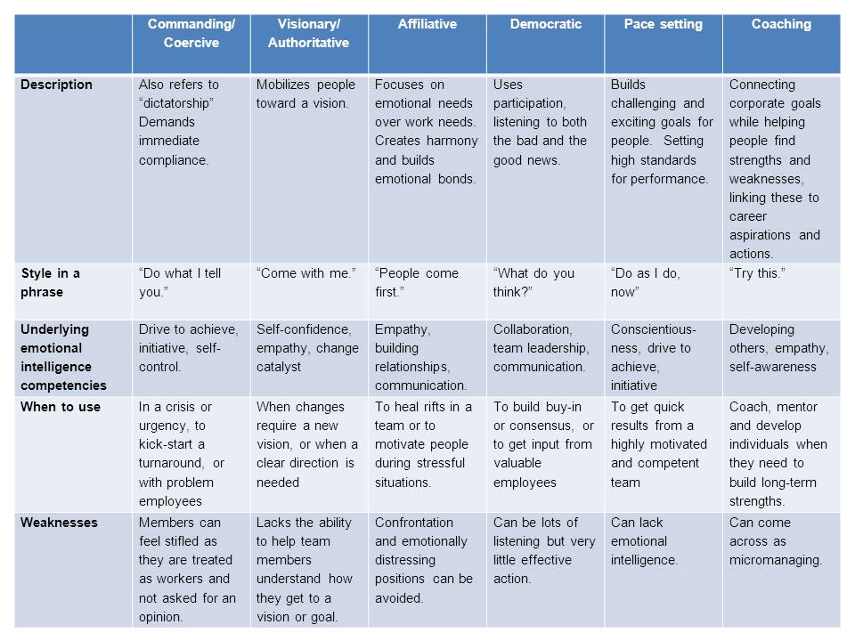
Some great theory out there: on context

Slide 31
Leadership style as a repertoire – some key questions
How are they most comfortable as a leader?
What styles/approaches are uncomfortable?
When under pressure, how do they react as a leader?
How will they balance that?
What type of leader do they need to be in the next 6 months?

Slide 32
How can we help them understand & develop their style and a repetoire?
What do we currently do?
How can we improve/build on this?
Small group discussion

Slide 33
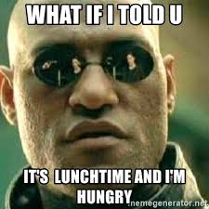
Lunch 30 min

Slide 34
Taking stock— Where do we want to be in terms of growing leadership capacity?

Slide 35
What is a “typical” entrepreneur at Unltd (before & after)?
From a leadership perspective--
What are/aren’t they?
What do they need/want/know/do?
What do we want them to be/know/do when they leave us?
Rather than an endpoint, can we develop a continuum to use?
Small group discussion

Slide 36
What do we need to help them improve?
What is in place and what do we need in terms of:
Materials
Approaches
Internal support/expertise
Small group discussion

Slide 37
How will we assess or measure and track this?
What is in place?
How can we build/improve on this?
How do we help them to continue to use similar approaches?
Small group discussion

Slide 38


Next steps

Slide 39

Preview of next workshops
Moving from internal capacity to outward activity
Leading & Managing Teams
Finding great teams – culture/values, planning, recruiting & onboarding
Retaining & growing great teams –team-building, professional development & building leaders & dealing with conflict

